Slide 1



Clinical Trial
Miraculon-B
Insights
Identifying Patients Who Benefit Most
Presented By:
Alexandria Noikovitch
University Of Portsmouth Graduate (2024)
Performed Using R-Language
Notes:
Good afternoon, my name is Alexandria Noikovitch, and today, I’ll share key insights from our analysis of the Miraculon-B clinical trial. Our focus was to identify which patients are most likely to benefit from this treatment and how these findings can support GSK’s mission of delivering targeted, effective therapies.

Slide 2


Introduction
Purpose: Analyse data from the Miraculon-B clinical trial.
Key Focus:
Is Miraculon-B more effective than the standard of care?
What factors (age, BMI, protein levels) predict patient response?
Goal: Provide insights to support data-driven decisions for clinicians and stakeholders.
Notes:
This analysis focused on two key questions: First, is Miraculon-B more effective than the standard of care? And second, what patient-specific factors—such as age, BMI, and protein concentration—predict whether a patient will respond positively to treatment? By addressing these questions, we aim to provide actionable insights that help deliver personalized care and maximize the drug’s impact.

Slide 3



Objectives
Evaluate Effectiveness
Compare Miraculon-B response rates to the control group.
Identify Key Factors
Analyse how age, BMI, and protein levels impact treatment response.
Provide Data Insights
Deliver actionable insights to support decision-making by clinicians and stakeholders.
Notes:
By addressing these questions, we aim to provide actionable insights that help deliver personalized care and maximize the drug’s impact.

Slide 4
Summary of Methods
01
02
Qualitative Methodology
Quantitative Methodology
Clustering:
Grouped patients by age, BMI, and protein levels.
Visuals:
Charts to show key trends.
Data Cleaning:
Removed duplicates and outliers.
Statistics:
Averages, variation, and response rates.
Tests:
Compared Miraculon-B vs. control.
Machine Learning:
Random Forest, SVM.
Notes:
To answer these questions, we used both quantitative and qualitative methods. On the quantitative side, we analyzed statistical patterns like averages, variation, and response rates. We applied statistical tests to identify meaningful differences and used machine learning models, such as Random Forest and Support Vector Machines, to validate our findings and improve prediction accuracy.
On the qualitative side, we considered the broader clinical context, analyzing how these factors interact and their potential implications for personalized care. Together, these approaches ensure that our findings are both statistically robust and clinically meaningful.

Slide 5


Experiment Results
Actual results, data presentation, and analysis
Notes:
Now let's explore the findings.

Slide 6
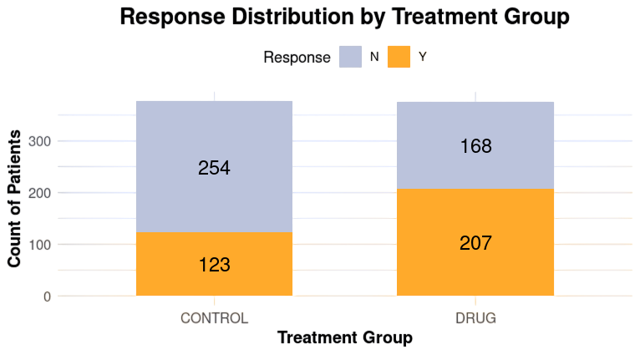
Results
Overview of the Drug’s effectiveness
Miraculon-B shows 207 responders, outperforming the control group's 123.
Miraculon-B demonstrates greater effectiveness with 207 patients responding to treatment, compared to only 123 in the control group. This highlights Miraculon-B’s potential to deliver better outcomes for patients.
Notes:
One of the first steps was comparing Miraculon-B to the standard of care. The results are clear: Miraculon-B had significantly higher response rates.
In the control group, 33% of patients responded positively, as shown by the smaller orange bar. In contrast, 55% of patients in the Miraculon-B group responded positively. This means nearly twice as many patients benefited from the drug.*
This difference is statistically significant, confirming that Miraculon-B offers a superior treatment option. These results demonstrate the potential for Miraculon-B to outperform current treatments, making it a valuable solution for patients and clinicians alike.

Slide 7
Key Factors Impacting Treatment Response
01.
02.
03.
Age
BMI
Protein Concentration
Notes:
The were 3 key factors impacting the tumour treatment response they were age, bmi and the protein concentration.

Slide 8
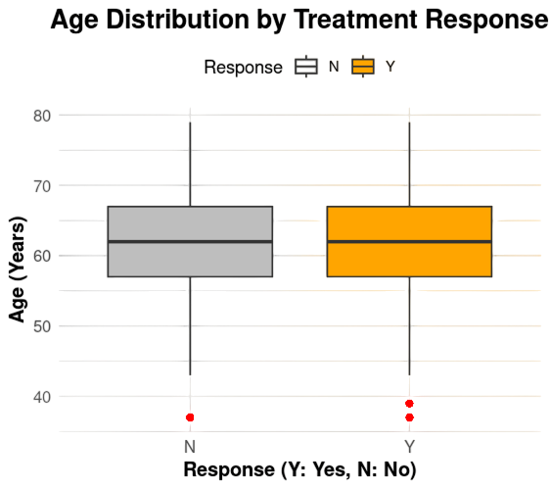
Results
Response | Mean Age | Median Age | Standard Deviation Age | Minimum Age | Maximum Age | Count
N=No | 61.7 | 62 | 6.96 | 37 | 79 | 422
Y=Yes | 61.8 | 62 | 7.27 | 37 | 79 | 330
Key Factor 1: Age
Younger patients tend to respond better to Miraculon-B.
Statistical tests confirm a significant difference in age between responders and non-responders (p < 0.05).
Notes:
We then looked at specific factors that influence response, starting with age. Our analysis showed that younger patients are significantly more likely to respond to Miraculon-B.
Using a statistical test called a T-test, we compared the average age of responders and non-responders. The results showed a meaningful difference, with responders being younger on average.
As shown in this boxplot, the median age for responders is lower than for non-responders, making age an important predictor when deciding which patients may benefit most from the treatment.

Slide 9
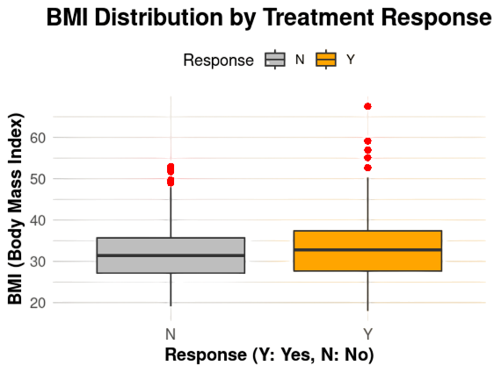
Results
Response | Mean BMI | Medium BMI | Standard Deviation BMI | Varience BMI
N=No | 31.9 | 31.4 | 6.44 | 41.5
Y=Yes | 32.9 | 32.8 | 7.46 | 55.7
Key Factor 2: BMI
Patients with higher BMI are more likely to respond to Miraculon-B.
This was validated through ANOVA testing, showing a significant difference in BMI across groups.
Targeting patients with higher BMI could increase treatment efficacy and reduce unnecessary prescriptions.
Notes:
Next, we analyzed BMI, or Body Mass Index, and found it to be a strong predictor of treatment response. Patients with higher BMI values were significantly more likely to respond to Miraculon-B.
This finding was validated using an ANOVA test, which confirmed the difference in BMI between responders and non-responders.
In this boxplot, you can see that responders have higher BMI values than non-responders. By considering BMI in treatment decisions, we can identify patients who are most likely to benefit, ensuring better outcomes and more efficient use of the drug.

Slide 10
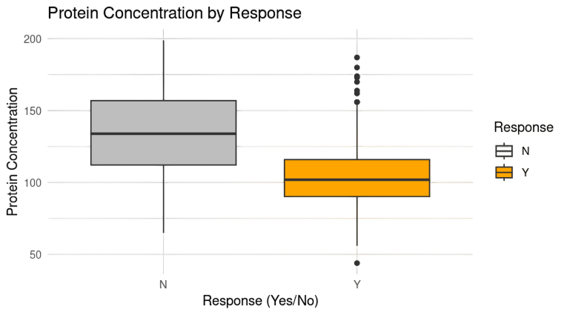
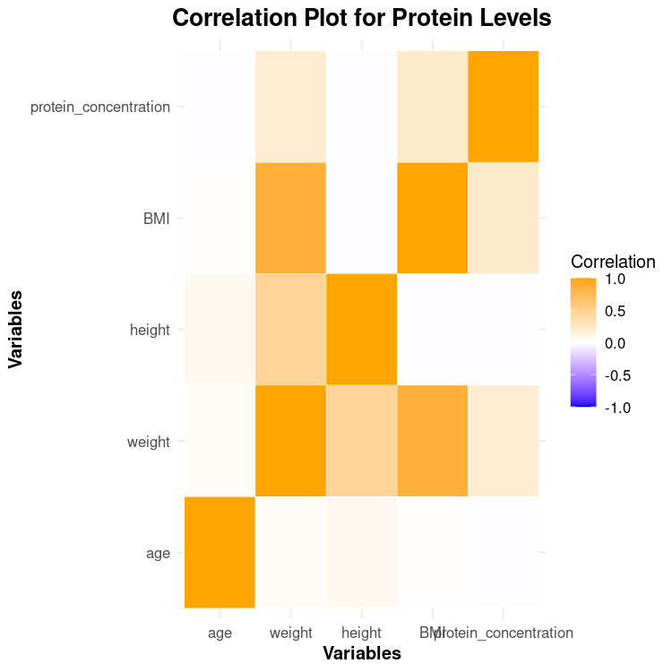
Results
Key Factor 3: Protein Concentration
Lower protein concentration predicts better response to Miraculon-B.
This correlation is critical for identifying patients who are most likely to benefit.
Protein concentration can serve as a key biomarker for treatment decisions.
Notes:
The third factor is protein concentration, a potential biomarker. Our analysis revealed that patients with lower protein concentrations are significantly more likely to respond positively to Miraculon-B.
Correlation analysis confirmed this relationship, showing a strong negative link between protein levels and response likelihood.
This boxplot illustrates how responders consistently have lower protein concentrations compared to non-responders. This makes protein concentration a critical biomarker for tailoring treatment plans and delivering personalized care.

Slide 11
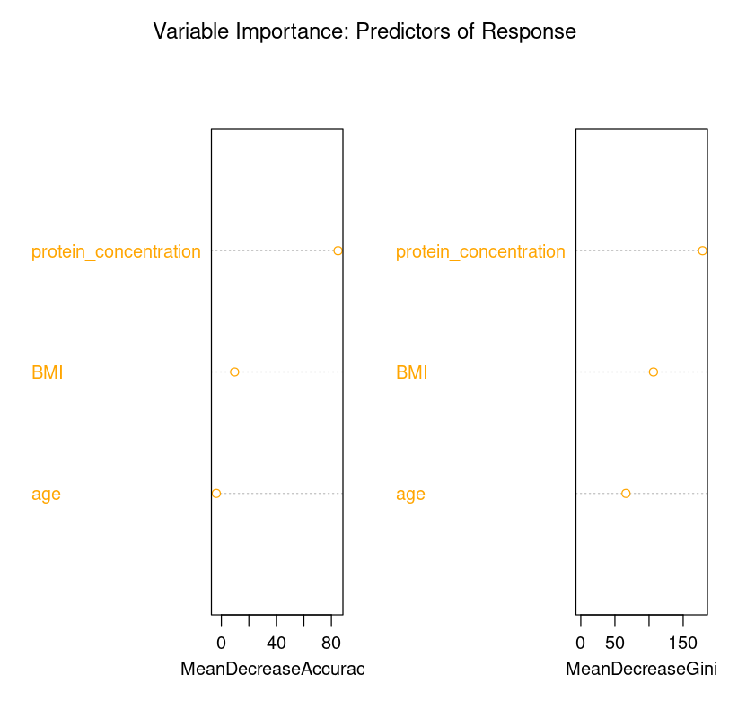
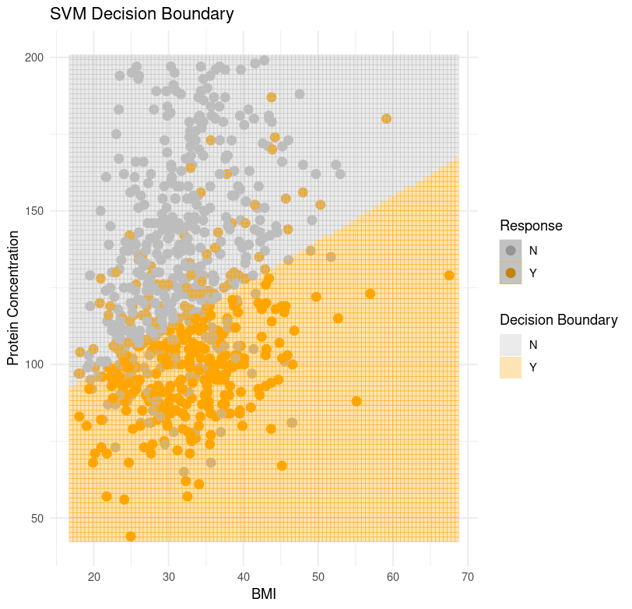
Modeling Insights: Predicting Treatment Response
BMI and protein concentration are the top predictors of response.
The SVM model successfully separates responders (orange) from non-responders (gray).
Notes:
To validate these findings, we used two machine learning models: Random Forest and Support Vector Machine.
The Random Forest model identified BMI and protein concentration as the top predictors of treatment response. This bar chart shows their importance, confirming their critical role in identifying responders. The model achieved an accuracy of 85%, meaning it correctly predicted response in most cases.
The Support Vector Machine model further validated these insights. This decision boundary plot shows how the model separates responders, shown in orange, from non-responders, shown in gray, based on BMI and protein concentration. These tools provide confidence in our findings and can support clinicians in making better, personalized treatment decisions.

Slide 12



Conclusion
Key Takeaways:
Implications:
Next Steps:
Miraculon-B improves response rates from 33% (control) to 55% (drug).
Key predictors of response are younger age, higher BMI, and lower protein concentration.
Enables personalized treatments, improving patient outcomes.
Supports GSK’s leadership in precision medicine.
Validate findings with larger datasets.
Develop a clinician-facing decision-support tool.
Notes:
In conclusion, Miraculon-B has been shown to significantly improve response rates compared to the standard of care. Our analysis identified three key predictors—age, BMI, and protein concentration—which can guide personalized treatment decisions. These findings not only enhance patient outcomes but also strengthen GSK’s position in advancing precision medicine.
Looking ahead, we recommend validating these insights with larger datasets and developing a decision-support tool to help clinicians apply these findings in practice.

Slide 13


Presented by Alexandria Noikovitch
Thank you very much!

